Slide 1

IFN 649 Advanced Networks Assessment1
Lecturers: Prof Raja Jurdak
Dr. Gowri Ramachandran
Tutor name: Jun Wook Heo
Student ID： N10629297
Student Name： Chen Yun（Michael）

Slide 2







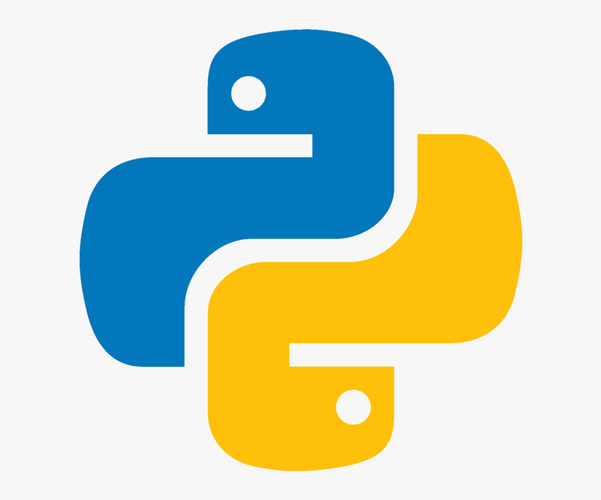





IoT System
MQTT
AWS
EC2
Linux
Socket
Subscribe
Publish
Linux
End User
Edge Computing
For this case
MQTT Service deployed in AWS EC2 instance (Linux OS)
Response transmit the message
Using Socket interface (TCP )
MQTT Client running in Raspberry Pi (Linux OS)
Using a Script of Python to Sub & Pub message
Retrieve and Send data from or to Teensy by BT
Teensy with some sensors
Collect data or controlled by edge computing devices
LoRa
WIFI 6
Bluetooth
Sensors

Slide 3
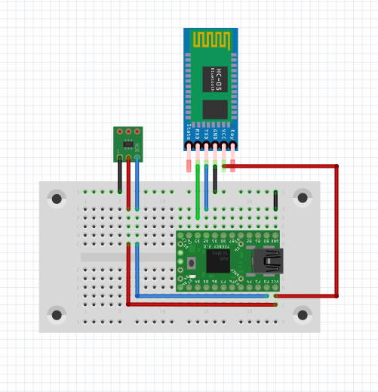
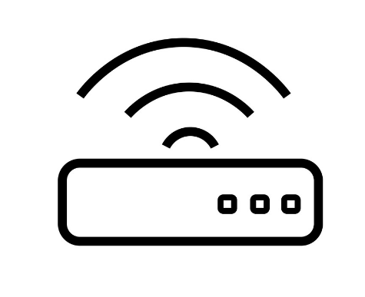

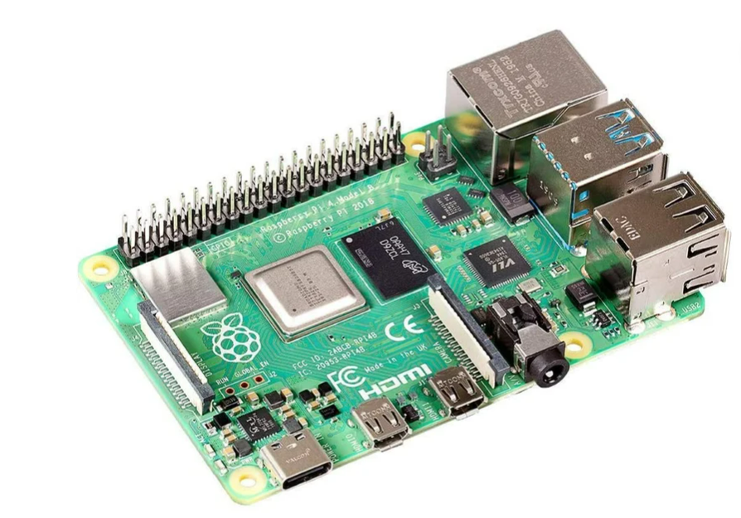
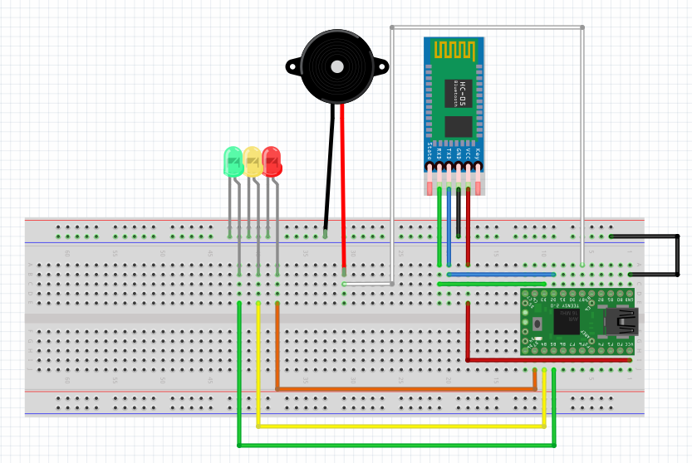
Hardware Architecture
Room1201
Serial：rfcomm0
Edge Computing
Alarm
Serial：rfcomm2
Room1201
Serial：rfcomm1

Slide 4
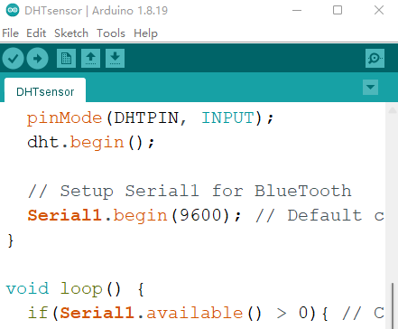
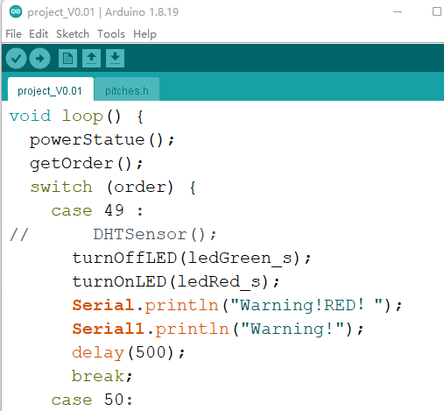
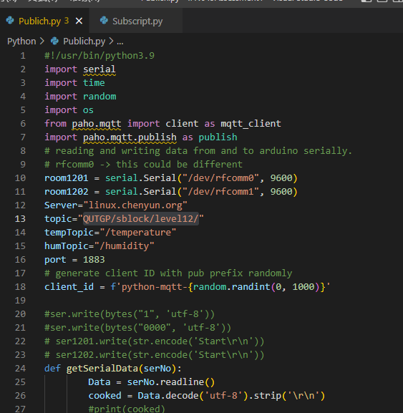
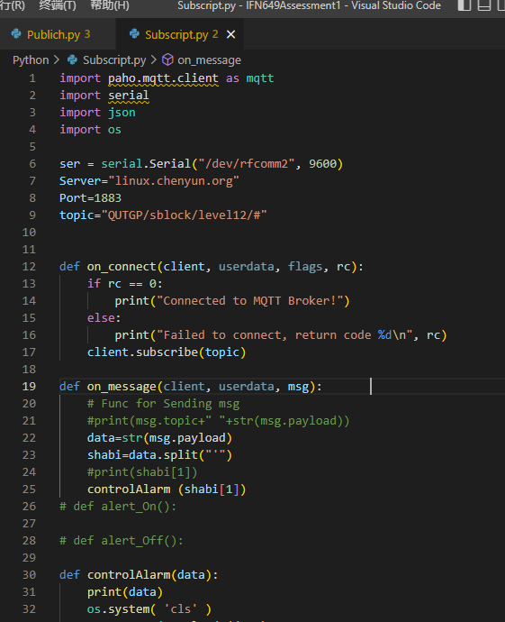
Software & Programming
Arduino
DHT Sensor & Alarm Control
Python
Publish & Subscript

Slide 6
Hardware
Software
Protocol

